Slide 1
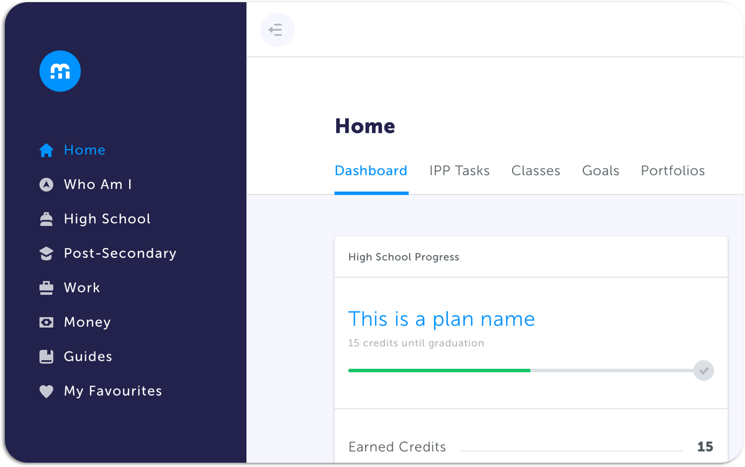
Education Planner Workshop
High School Plan
Notes:
Start your presentation with this slide

Slide 2
Agenda
Introductions
Benefits of myBlueprint
How to Log In
High School Planner Demo
Playtime
Discussion + Q&A

Slide 3
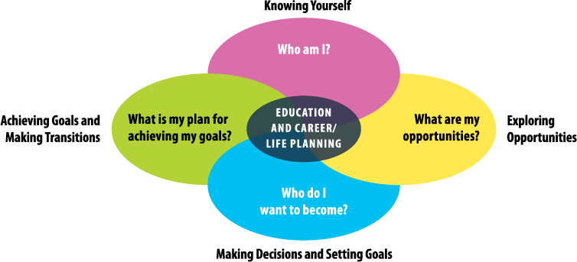
Student-Centered & Inquiry-Based Approach
Notes:
We are now ready to answer the last question in Workshop #3 What is my plan for achieving my goals?
-

Slide 4
How to Log In

Slide 5
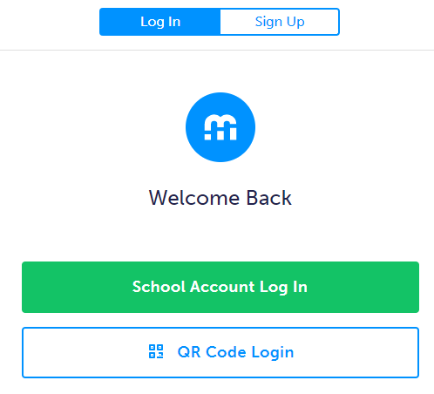
Student Log In / Account Creation
Visit www.myBlueprint.ca/anglophonesouth
Click School Account Login and they can sign in with their school email/username and password
Pro Tip for Teachers: You can find these instructions in your Teacher account!
Click the Help button in the bottom right corner of your teacher account
Click Get Students Started on the pop-up menu

Slide 6
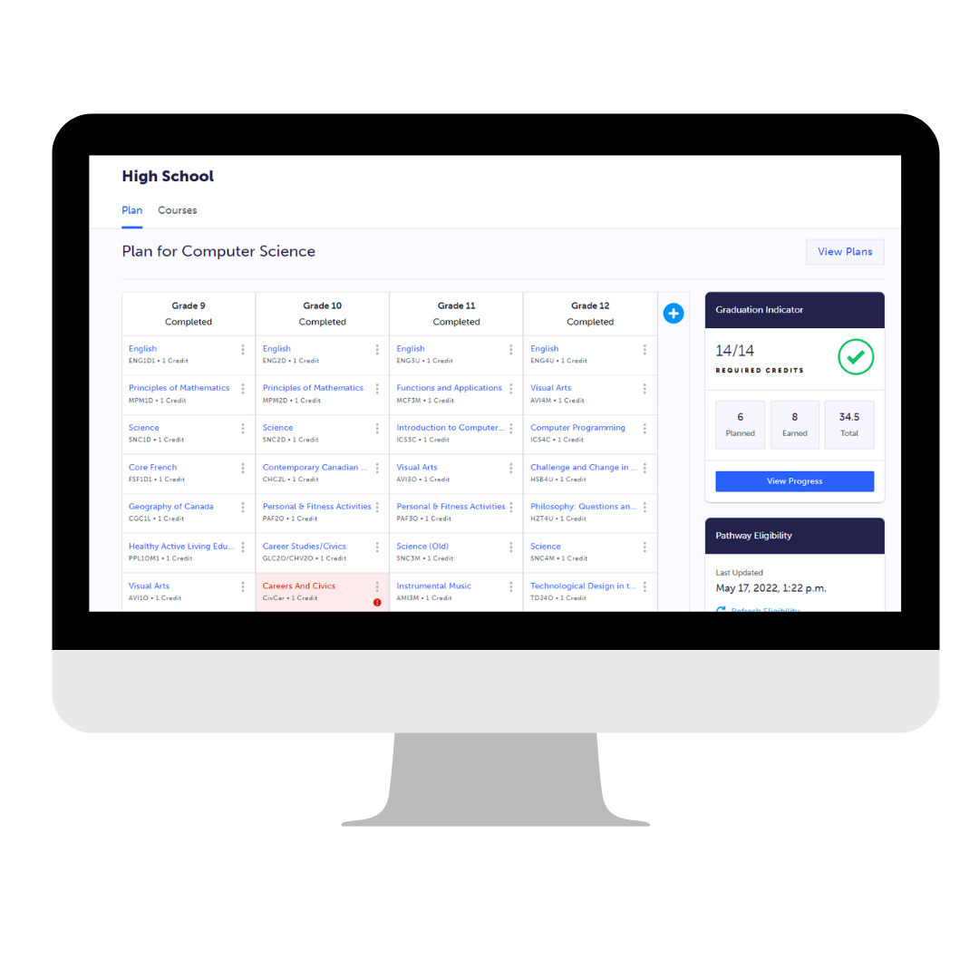
Student Account Demo
High School Planner
Notes:
Pause the presentation and provide a demo of the Student Account - High School Planner feature to your team!
You have two options:
Use the ‘Student View’ feature in your Counsellor/Teacher account to personally demonstrate the feature
If this is the approach you want to take, we suggest showing…
a) How to find the high school planner on the site
b) How to add courses to the planner and how to view course descriptions + prerequisites
c) How to create multiple plans
c) How to view the Graduation Indicator for progress towards graduation (show how they can change grad requirements)
d) How their course selections impact the Pathway Eligibility Box
Instead of demoing the process yourself, you can watch the High School Planner (micro video) from our myBlueprint website (3m 28s)

Slide 7
Student Account Playtime
High School Plan Creation
Notes:
Give your audience time to explore the High School Planner. We suggest at least 15 minutes.
Considerations:
Consider sharing the Forwards and Backwards Planning Guide with the audience to show how to effectively plan for their future in Education Planner
a) Having students start their planning in the High School Planner is the Forwards Plan (i.e., High School Planner > Pathway Eligibility > Programs of interest > Related Occupations)

Slide 8
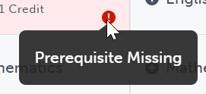
Playtime: High School Plan
A
B
C
D
E
PRO TIP:
Review your Career Life Portfolios from last workshop to see your favourite programs and occupations. Add courses to your High School Plan that align with those favourites.
Select High School on the left navigation menu
First time creating a plan? Click Add Plan, select your diploma, and create a name for your plan. Click Create New Plan to get started
Already have an old plan and want to start fresh? Click View Plans in the top right corner and click Add New Plan. Select your diploma, write a name, and click Create New Plan
Click on boxes with a (+) in the High School Plan to add a course. Search keywords and use the available filters to help your search. Select a course to view the description and information about prerequisites & corequisites
Click Add Course to place the course into your High School Plan. If the box turns red, hover your cursor over the (!) icon to see what the issue is
Notes:
Give your audience time to explore the High School Planner. We suggest at least 15 minutes.
Considerations:
Consider sharing the Forwards and Backwards Planning Guide with the audience to show how to effectively plan for their future in Education Planner
a) Having students start their planning in the High School Planner is the Forwards Plan (i.e., High School Planner > Pathway Eligibility > Programs of interest > Related Occupations)

Slide 9
Discussion + Q&A
Now it’s time to have an open discussion to share ideas and ask questions!
Remember, questions that cannot be answered now will be recorded and shared with myBlueprint support.
Notes:
Some questions you can prompt your audience to discuss (together or in groups):
What was your favourite part of planning courses on myBlueprint’s Education Planner?
What type of occupation or program were you building your high school plan for? Why was this occupation/program interesting for you?
Which courses did you find that you didn’t know were offered? Did you add them to your plan, and if so, why?
Which pathway are you most interested in and why? (i.e., Apprenticeship, College, University, Work)

Slide 10
Next Steps for Students
Pro Tip:
Create multiple plans for different programs & occupations of interest
1
Complete your High Schools Plan(s)
2
Click View Progress on the Graduation Indicator to ensure you have met all your diploma requirements
3
Review your Pathway Eligibility to see if your programs of interest are attainable with your current plan
4
Add your High School Plan(s) to your Career Life Portfolio and include a reflection on your experience creating the plan(s)
5
Reach out to your Teacher or school Guidance Counsellor if you have any questions about your plan or need help with your pathways planning
Notes:
NEEDS UPDATE

Slide 11
Thank you
for your time!
support@myBlueprint.ca
1-888-901-5505

