Slide 1
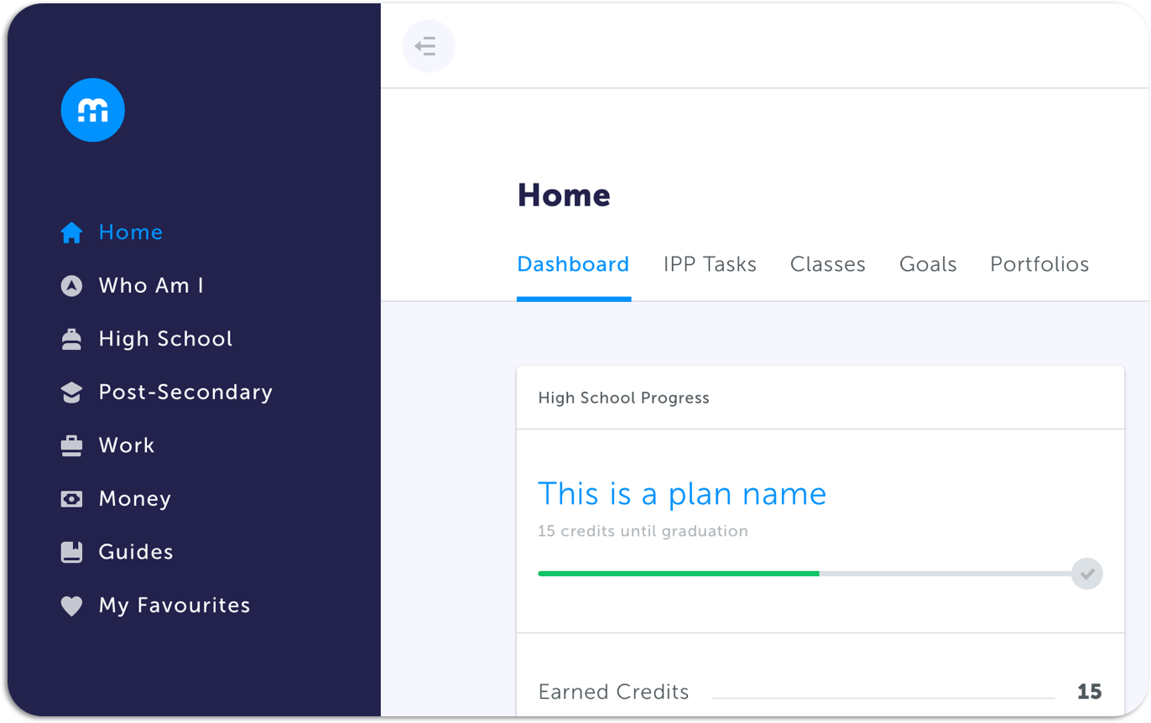
Education Planner Workshop
Occupation Search and Portfolios

Slide 2
Agenda
Introductions
Ice Breaker
How to Log In
Portfolio Demo
Occupation Search Demo
Exploratory Time
Reflection Questions

Slide 3
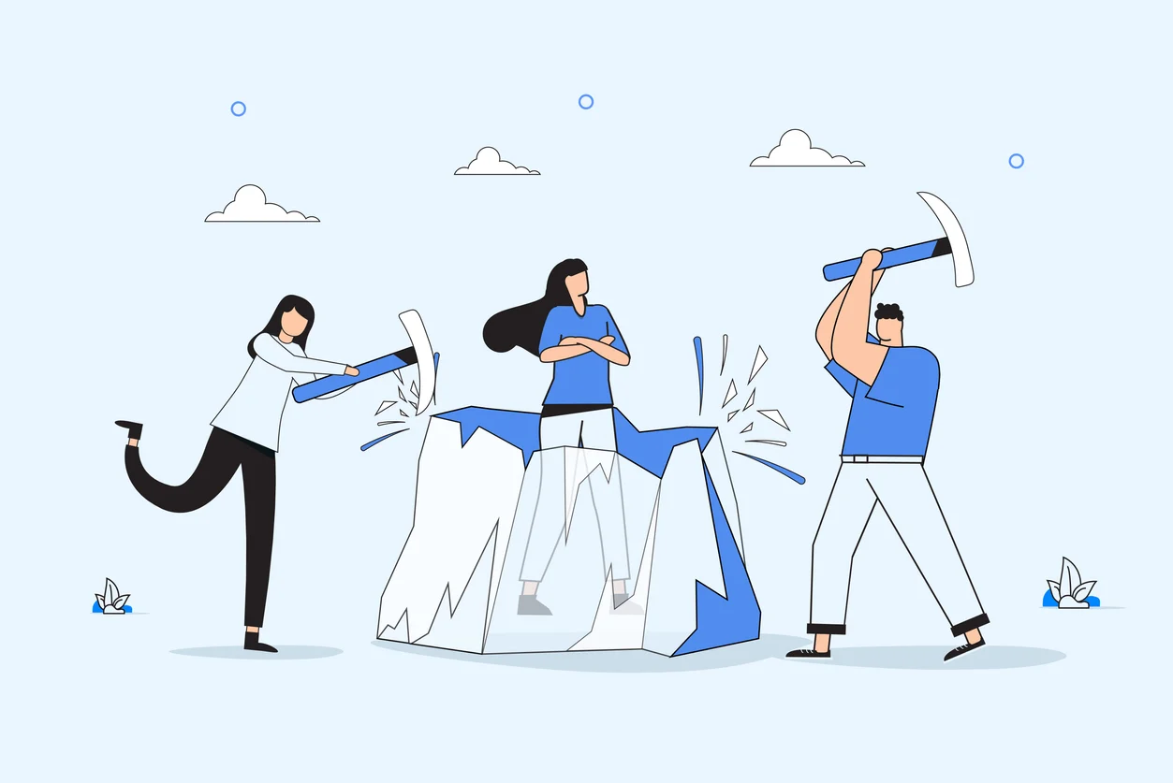
Ice Breaker
In the next two minutes, write down as many jobs as you can think of. Don’t worry about being perfect—just write what comes to mind.
Ready, set, go!

Slide 4
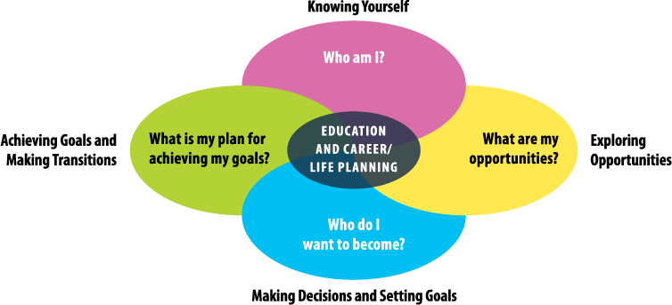
Student-Centered & Inquiry-Based Approach
Notes:
Knowing yourself is the first step to exploring career pathways. Ask students what would you want to consider about yourself when you making choices about the future? Interests, abilities, talents, learning style, personality, values, etc. Keep these things about yourself in mind as we do this workshop today. What are your interests, hobbies, favorite subjects, etc.
This workshop today will focus on these questions. – see arrows.
-

Slide 5
How to Log In

Slide 6
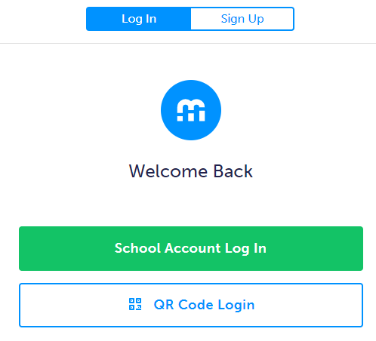
Student Log In / Account Creation
Visit www.myBlueprint.ca/anglophonewest
Click School Account Login and they can sign in with their school email/username and password
Pro Tip for Teachers: You can find these instructions in your Teacher account!
Click the Help button in the bottom right corner of your teacher account
Click Get Students Started on the pop-up menu

Slide 7
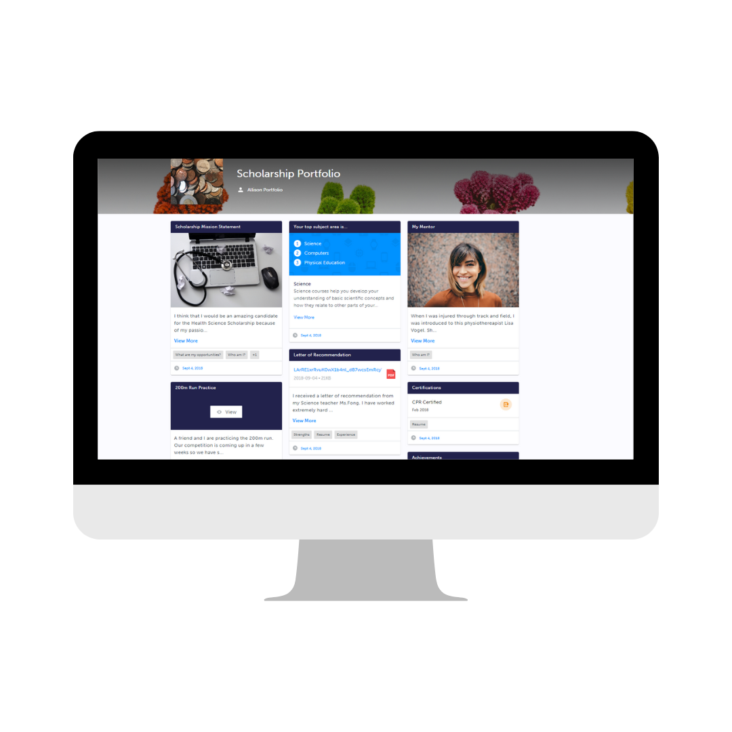
Student Account Demo
Portfolios
Notes:
Pause the presentation and provide a demo of the Student Account - Portfolios feature to your team!
You have two options:
Use the ‘Student View’ feature in your Counsellor/Teacher account to personally demonstrate the feature
If this is the approach you want to take, we suggest pre-creating a demo portfolio with some pre-created artifacts that you can show to the audience. We recommend showing how you can…
a) Create a portfolio (and customize avatar and banner images)
b) Add artifacts to a portfolio (explain the different types of artifacts you can add)
c) How to add a reflection
d) How to share your portfolio with others
Instead of demoing the process yourself, you can watch the Portfolios (micro-video) from our myBlueprint website (3m 17s)

Slide 8
Next Steps for Students
1
Create a Career Life Plan portfolio by clicking Add Portfolio
2
Add an avatar and/or banner image if you would like
3
Add Journal – Title: Who Am I
Share something about you – your favorite subject in school or your favorite hobby/activity and why.

Slide 9
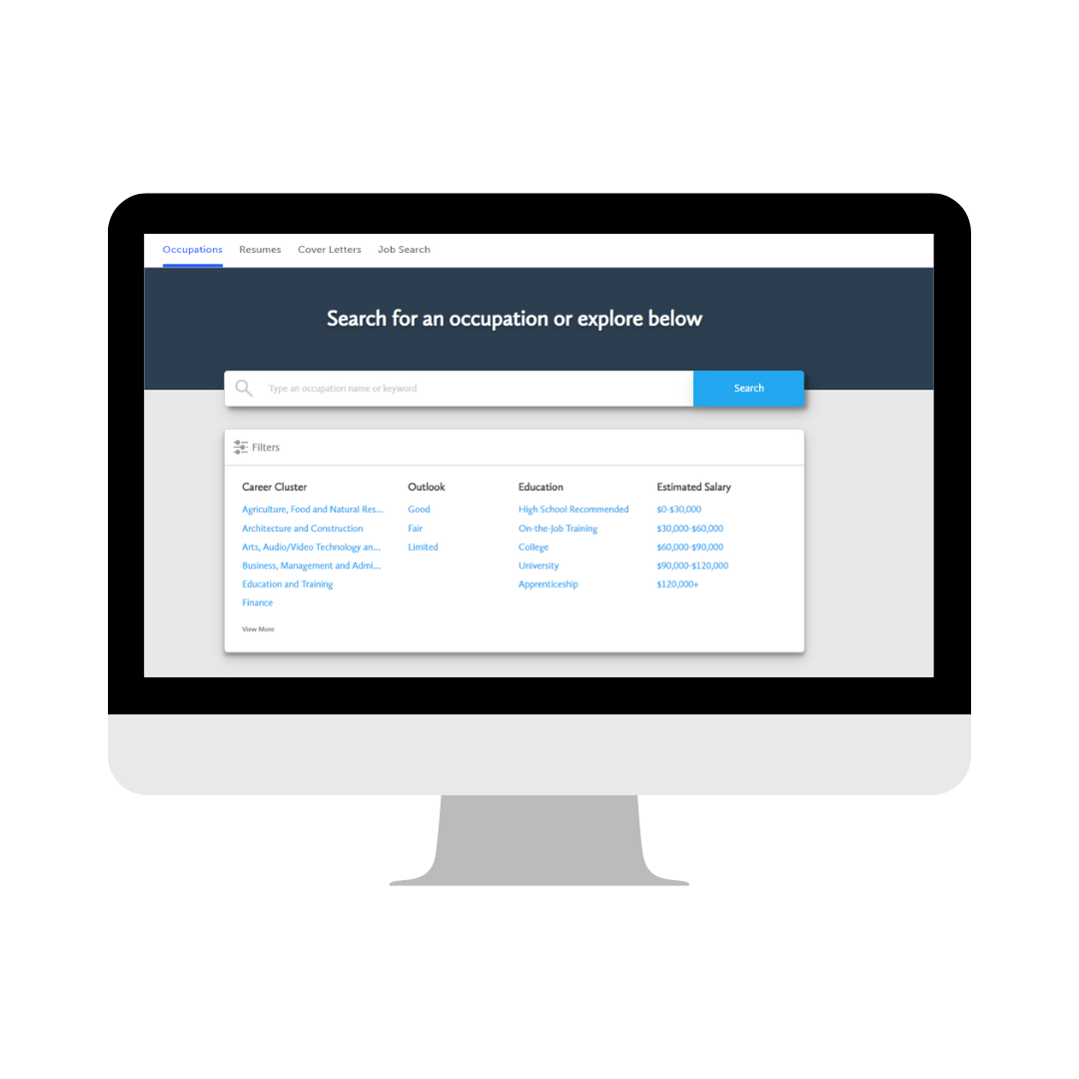
Student Account Demo
Occupation Search
Notes:
Pause the presentation and provide a demo of the Student Account - Occupation Search feature to your team!
You have two options:
Use the ‘Student View’ feature in your Counsellor/Teacher account to personally demonstrate the feature
If this is the approach you want to take, we suggest showing how you can…
a) Navigate to the occupation search feature through the work section of Education Planner
b) How to leverage filters to narrow down search results
b) Highlight the information available within each career profile (Overview, Outlook, and Requirements)
c) Showcase the “Do I Match” section and motivate students to complete compatibility surveys for occupations of interest
c) How to favourite an occupation and/or add one to a portfolio
d) How to compare occupations allowing for a side-by-side comparison >> (i.e., hover your cursor on an occupation box, click the 3 dots on the top right corner, click Compare; do this for another occupation)
Instead of demoing the process yourself, you can watch the Occupations (micro-video) from our myBlueprint website (3m 17s)

Slide 10
Student Account Exploratory Time
Portfolio Creation & Occupation Search
Notes:
Now is the students exploring time. You will put up the next slide so they can see the tasks they need to complete. You can circulate the room and have career conversations with students.

Slide 11
Next Steps for Students
1
Create a Career Life Plan portfolio by clicking Add Portfolio
2
Search for occupations of interest (maybe one you have never heard of before?)
3
Add your top two occupations of interest to your Career Life Plan portfolio
4
Write a reflection for each occupation in your portfolio – why would this be a good choice for you?

Slide 12
Reflection Question
1.What did you learn about your options for the future?
2. What do you think you will need to do now and in middle school to help you achieve the future you would like for yourself?
3.What are some things you could do in middle school to explore different career options?
4. What is one thing you have learned about yourself today?
Notes:
Conduct a class discussion to wrap up the class.

Slide 13
Thank you
for your time!
support@myBlueprint.ca
1-888-901-5505

