Slide 1
Career Life Plan
Introduction & Who am I Surveys

Slide 2
First steps..
Have you logged into myBlueprint yet this year?
If no, please do so first (If you are having issues logging in, please go to the cafeteria)
If yes, please continue to the next step
Go to myBlueprint Portfolios and click “Add a Portfolio.” Please call this portfolio “Career Life Plan”

Slide 3
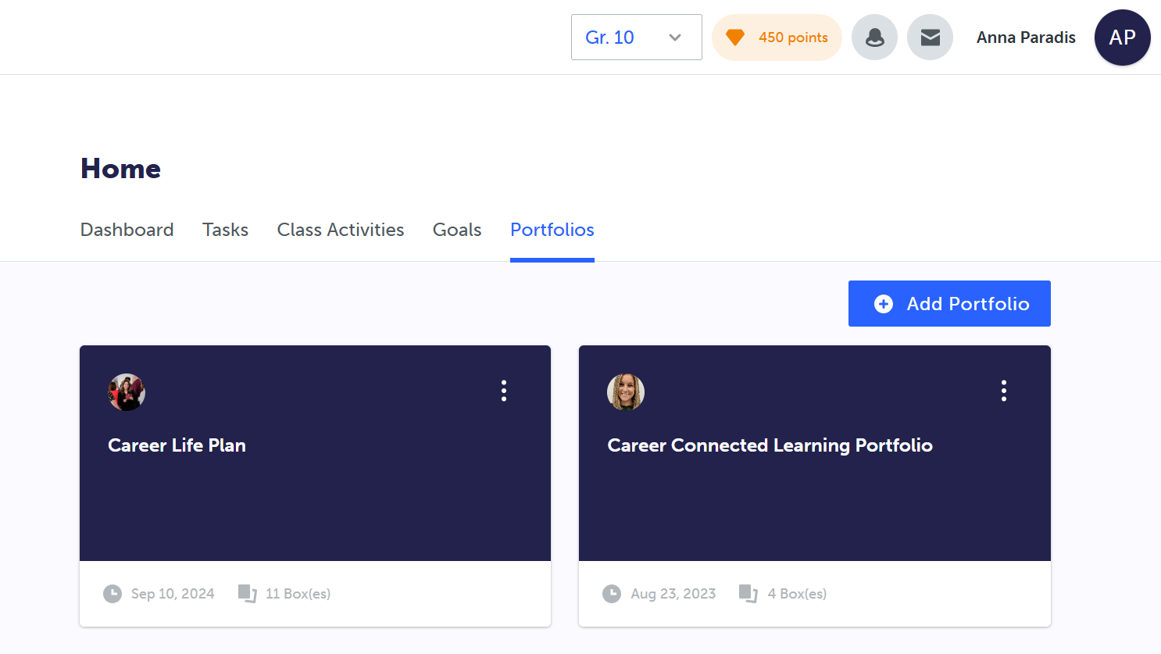

Slide 5
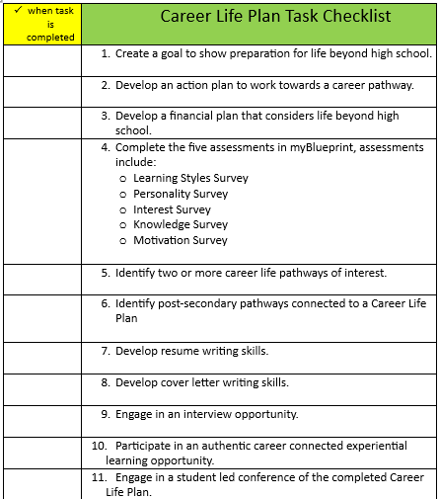
Notes:
Overview of all tasks

Slide 6
Steps to add to your Portfolio
If you have completed the Who Am I surveys, Favourited Occupations, or have other items already completed in your myBlueprint account that can be added to your Career Life Plan Digital Portfolio, please:
Click the Green “Add Box” button in your Career Life Plan
Select “Add from myBlueprint”
You will see what you have already completed, please select the blue “plus” button on the top right-hand corner of each item.

Slide 7
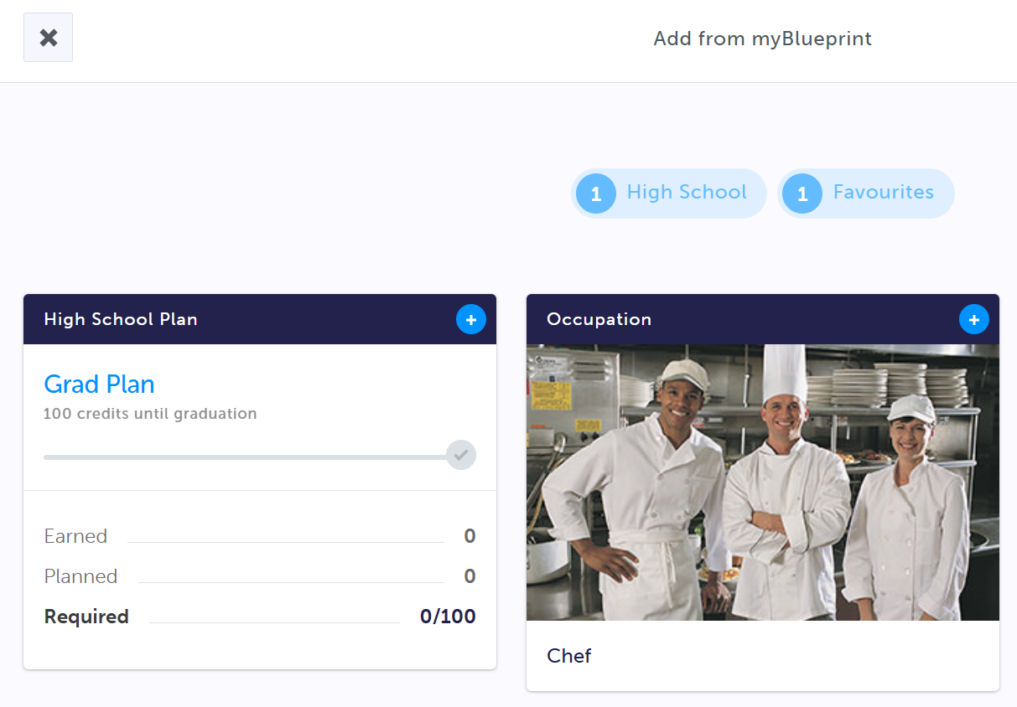
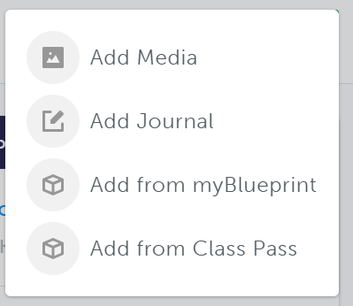
#1
#3
#2

Slide 8
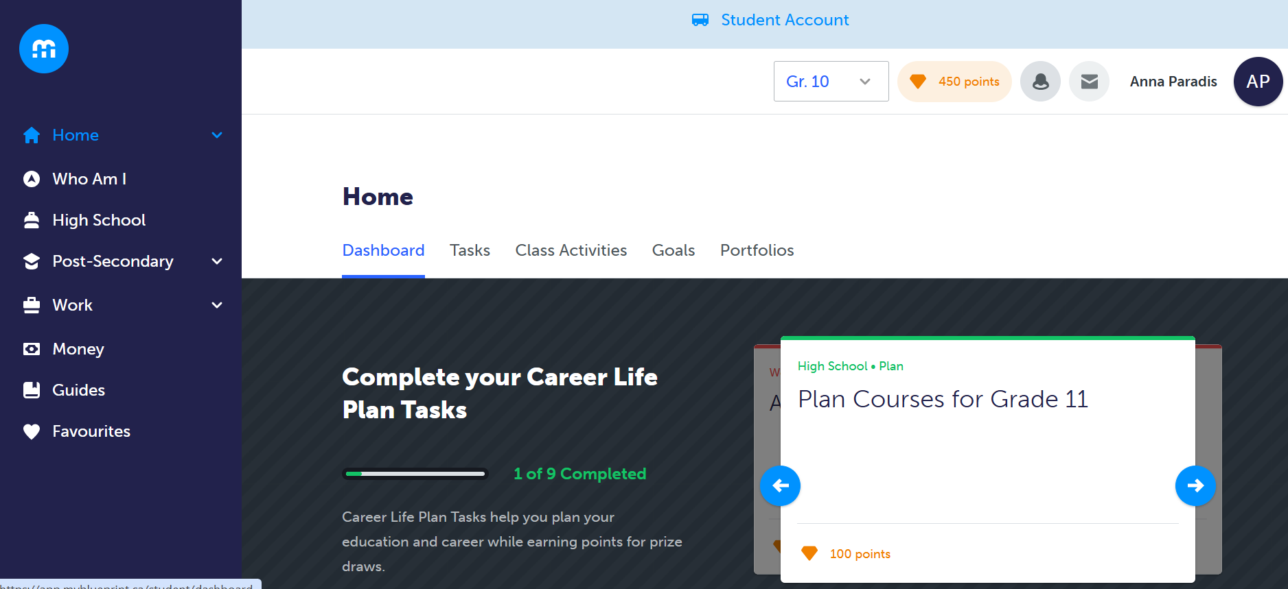
Complete the Who Am I Surveys
Notes:
Encourage students to redo the surveys if they have not done them in the last year

Slide 9
Restarting a Survey
Notes:
If students have not completed the survey in the last year, they can save their surveys to their Career Life Plan portfolio before restarting. This way they can compare their results to see if there are any changes.

Slide 10
Steps to add Tags
To keep your Career Life Plan tasks organized, please add a “tag” to your entries.
To do so,
Click on the 3 lines on the right-hand side of your “box”
Select “tags”
Type in what you want the tag to be called (I.e., “Career Life Plan Tasks #1”

Slide 11
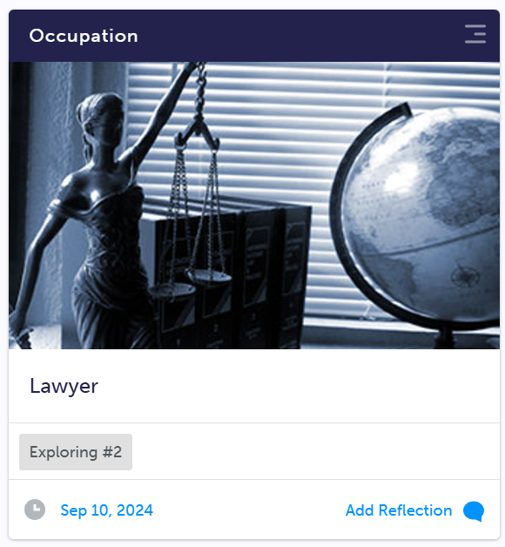
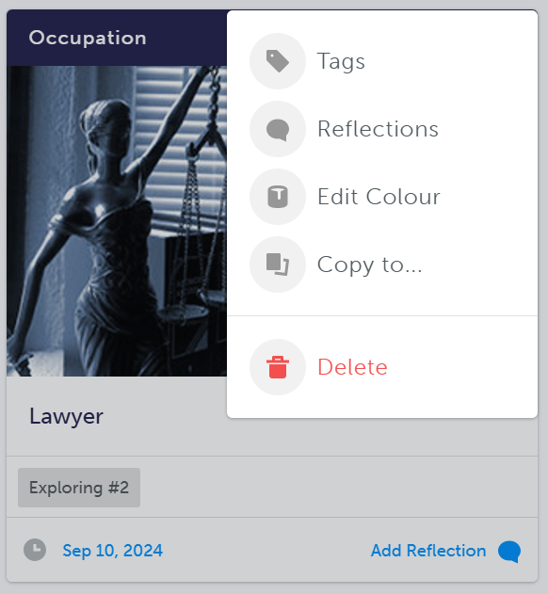
#1
#2

