Slide 1
Career Life Plan
Identify 2 or more Career Life Pathways of Interest

Slide 2
First steps..
Have you logged into myBlueprint yet this year?
If no, please do so first (If you are having issues logging in, please go to the cafeteria)
If yes, please continue to the next step
Go to myBlueprint Portfolios and click “Add a Portfolio.” Please call this portfolio “Career Life Plan”
Ensure all “Who am I Surveys” are completed

Slide 3
Identifying 2 Career Life Pathways of Interest
Once you have completed all the Who Am I surveys, you will have suggestions for potential occupations that may be a fit for you. You will begin looking through the suggestions to see if there are any occupations that you would like to explore in greater detail.
On the “Who Am I” tab (where the surveys were found) you will now see a tab that says “Match Results” you should click on the tab.

Slide 4
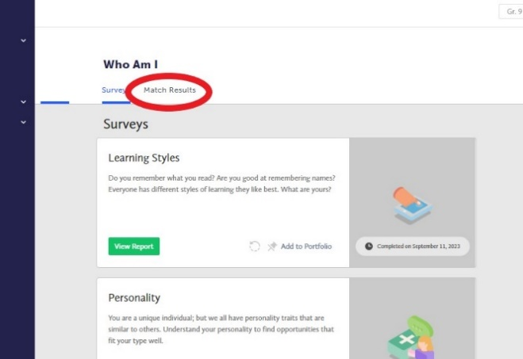

Slide 5
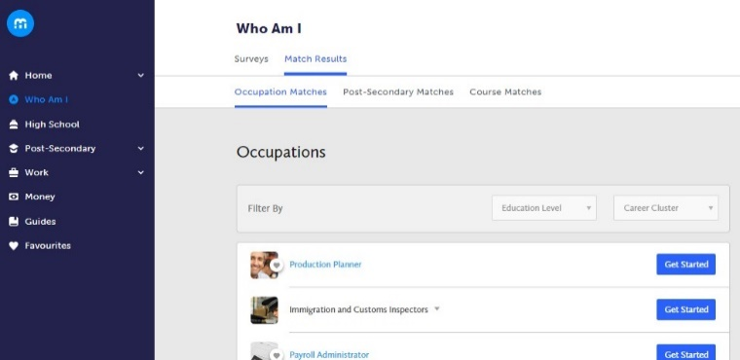
Identifying 2 Career Life Pathways of Interest
The new tab will allow you to explore occupations. Favourite a minimum of two occupation matches and learn more about the occupation.

Slide 6
Identifying 2 Career Life Pathways of Interest
For each of the occupations that you choose you can also do a quick quiz to determine what percentage you are a match for that occupation. To do the quiz click on the “get started” button.

Slide 7
Identifying 2 Career Life Pathways of Interest
Complete a journal entry for each career and add it to your Career Life Plan portfolios. Use the following journal entry prompts:
What education, training, or certifications are required for this role, and what paths did others take to get here
(Provides clarity on the steps needed to enter the field.)
What is the average salary for this occupation?
(Help students understand financial status in relation to this career pathway)
What are the most important skills or qualities someone should have to be successful in this career?
(Helps students identify the key competencies they might need to develop.)
What opportunities for growth or advancement exist in this field?
(Encourages students to consider long-term prospects and career progression.)

Slide 8
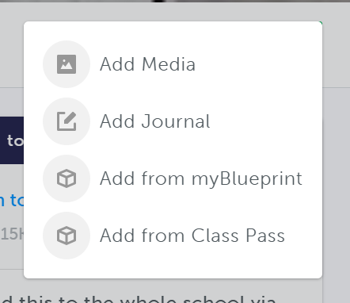
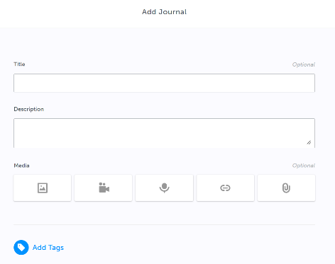
How to make a Journal Entry:
#3
#2
#1
Suggestion of what to type in the Title: “Career Life Plan Task – Identify career life pathway of interest”

