Slide 1
Career Life Plan
Identify post-secondary pathways connected to a Career Life Plan

Slide 2
Identifying Post-Secondary Pathways
Once you have completed all the Who Am I surveys, you will have suggestions for potential post-secondary options that may be a fit for you.
You will begin looking through the suggestions to see if there are any programs or institutions that you would like to explore in greater detail.
On the “Who Am I” tab you will now see a tab that says “Match Results” you should click on the tab, then “Post-Secondary Matches”

Slide 3
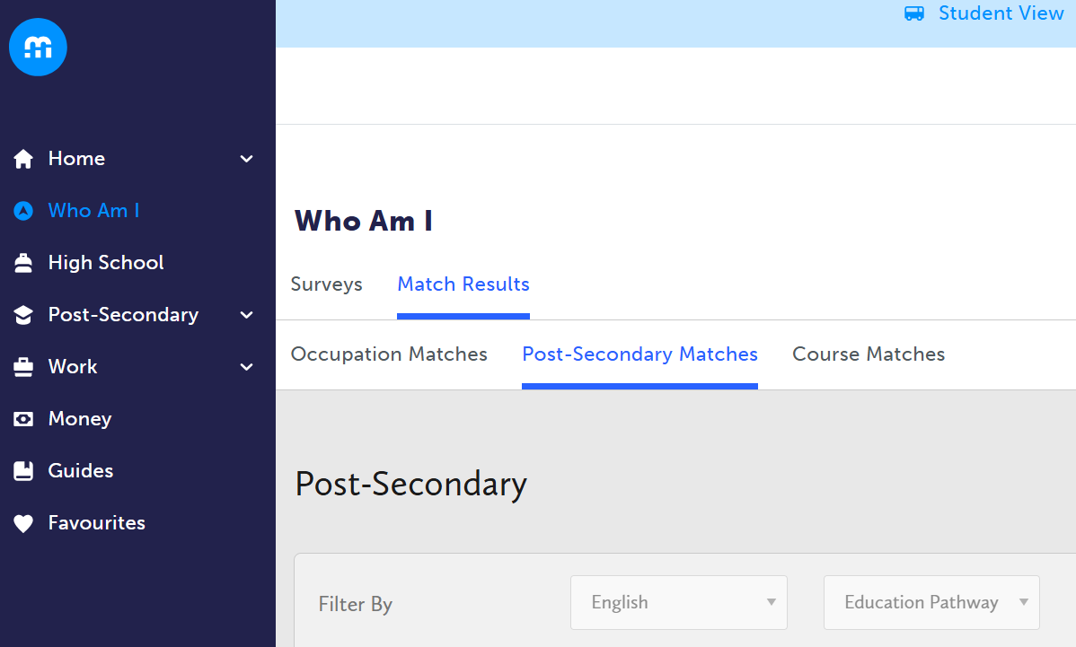
#1
#2
#3

Slide 4
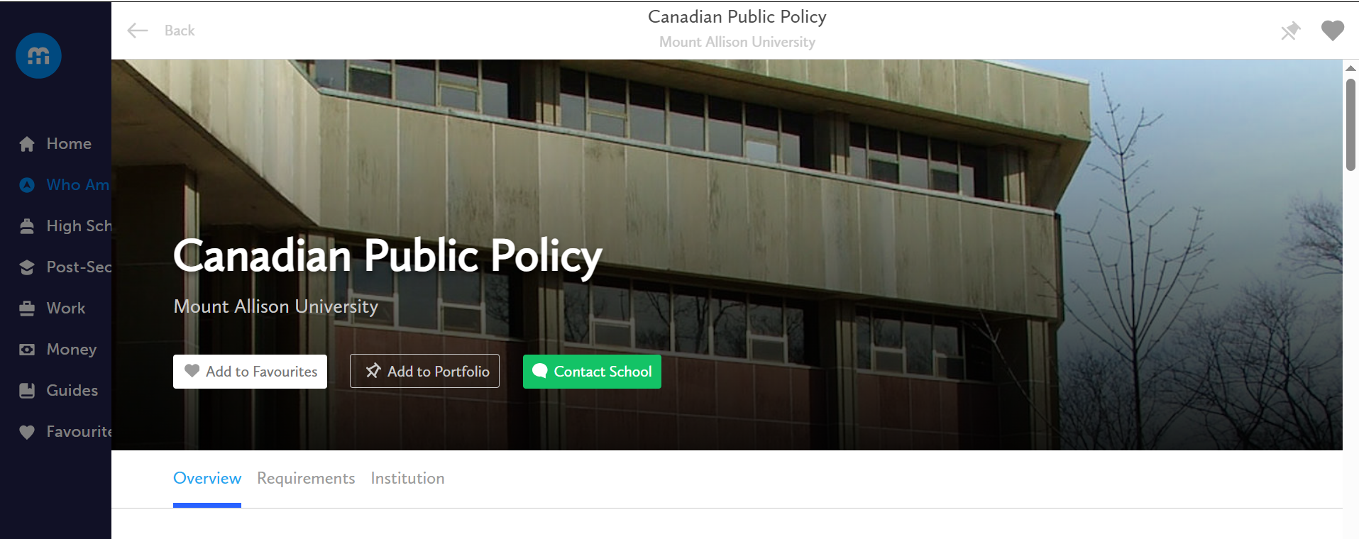
Identifying Post-Secondary Pathways
The new tab will allow you to explore post-secondary options. Favourite a minimum of two matches and learn more about the occupation.

Slide 5
Comparing Post-Secondary Pathways
Once you have favourited at least two post-secondary pathway options, you can compare your choices to see which one might be the best fit for you.
Using the Favourites tab on the left-hand side of myBlueprint, you can locate the options you have favourited.
Click on the dots next to what you have favourited, and hit compare. Repeat this process for both options.
Compare & contrast the details of each option. Consider things that are important to you (tuition, co-op option, length, etc.)

Slide 7
Identifying Post-Secondary Pathways
Once you have compared your post-secondary options and decided on at least two options that feel right to you, you can add them to your Career Life Plan portfolio. See how below:

Slide 8
Identifying Post-Secondary Pathways
Now that you have the details of your post-secondary pathway options, please fill in the Graphic Organizer provided by your teacher.
Once you have this filled in, you can take a picture and upload it to your Career Life Plan portfolio.
Please click “Add Box”, then “Add Media” and choose “File” if you are uploading from your laptop, if you are taking a picture and uploading it from your phone, click “Picture”.
Once the picture uploads, please choose a Title “I.e., Post-Secondary Options” and then “Post” to your Career Life Plan.

Slide 9
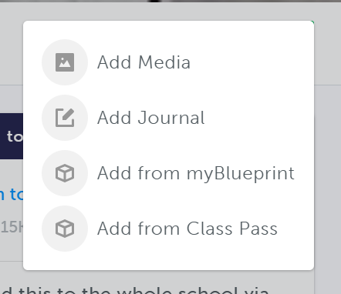
#1
#2

Slide 10
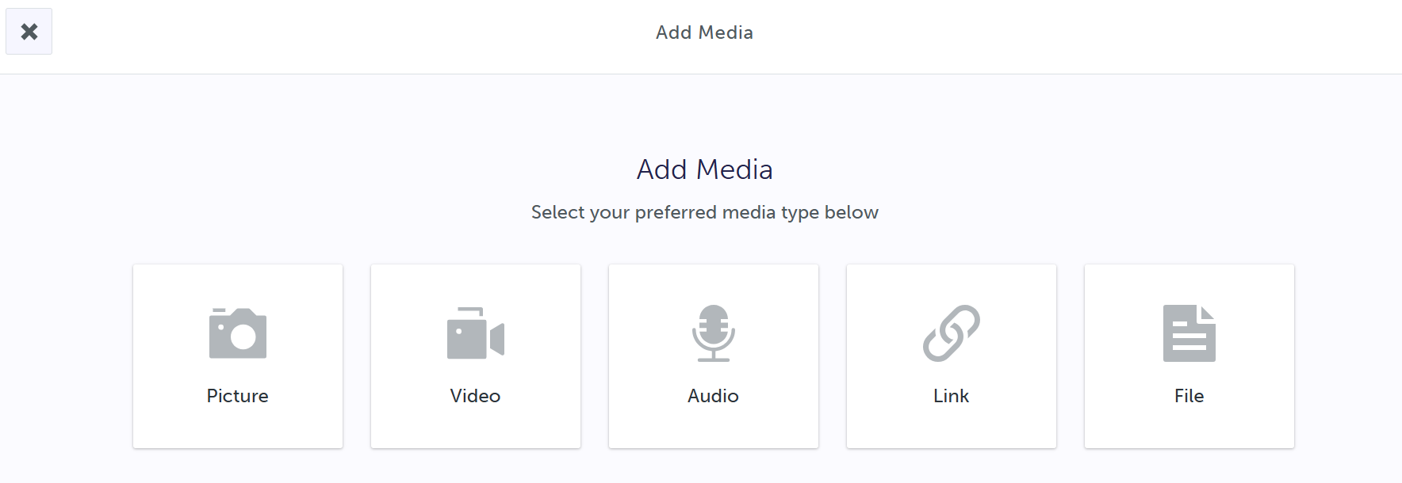
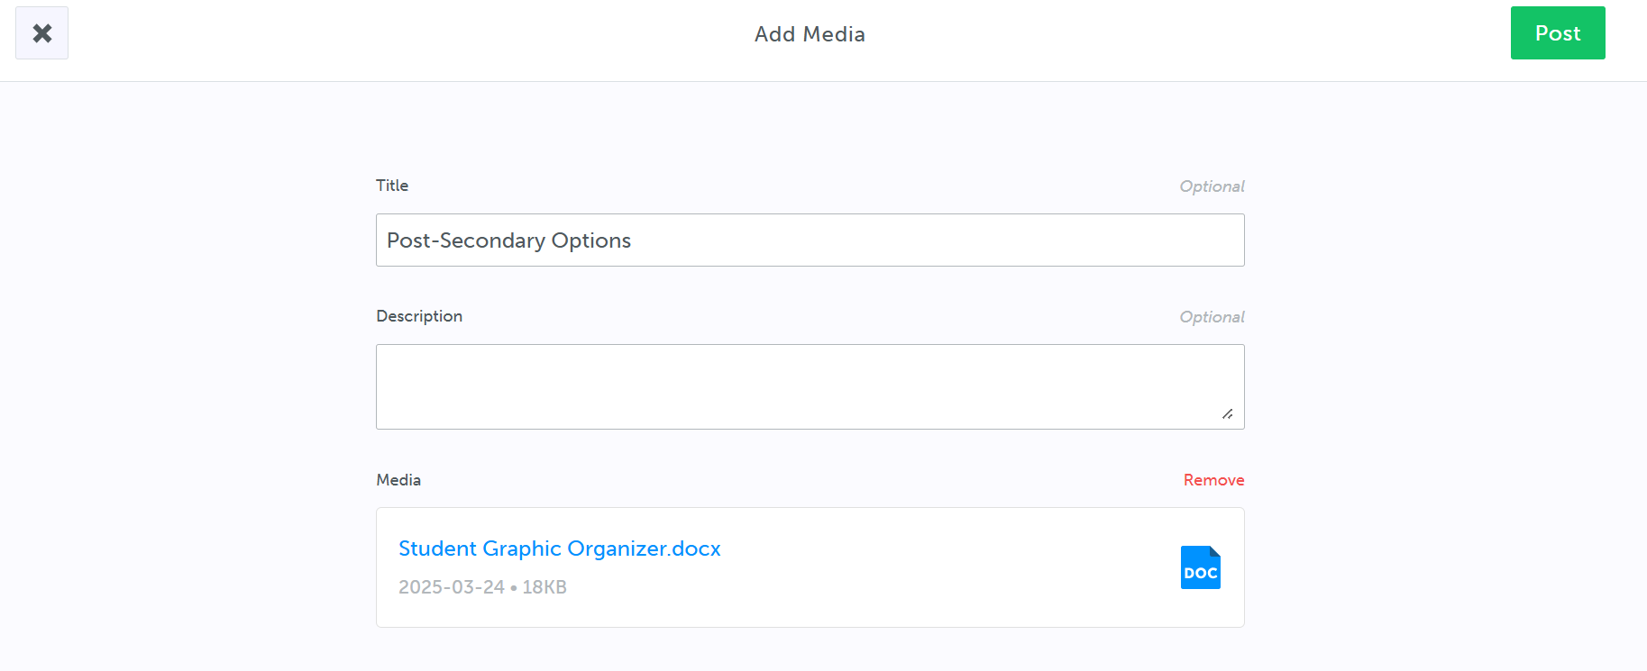
#3
#4

