Slide 1
Career Life Plan
Create a goal to show preparation for life beyond high school

Slide 2


Slide 3
Creating a Goal for Life after High School
Before diving into the Goal setting tool on myBlueprint, consider the following:
  What does life beyond high school look like for you?
  What skills or experiences do you think will help you succeed?
  What do you want to achieve in the next few years that will help you prepare for life after high school?
Write down some ideas

Slide 4
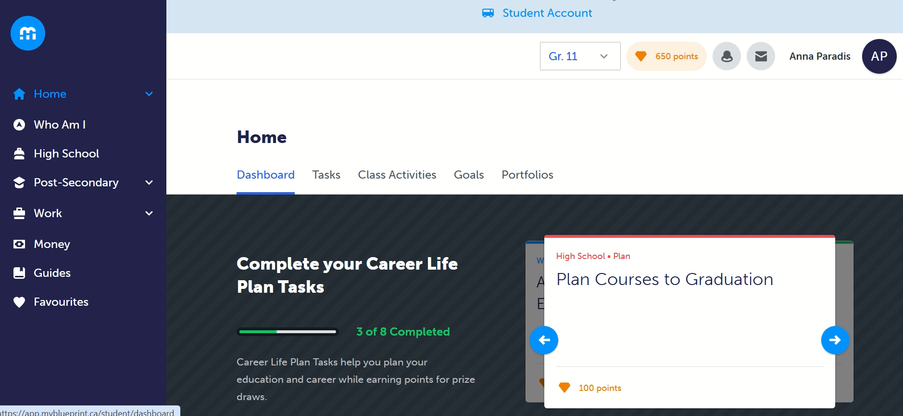

Slide 5
Creating a Goal for Life after High School
Now that you have created your goal to show preparation for life beyond high school, please add it to your Career Life Plan and ensure you are revisiting your goal and the specific tasks you have identified.
By clicking on the three little dots next to your goal, you can select “Add to Portfolio” so that your goal is saved to your Career Life Plan portfolio.

Slide 6
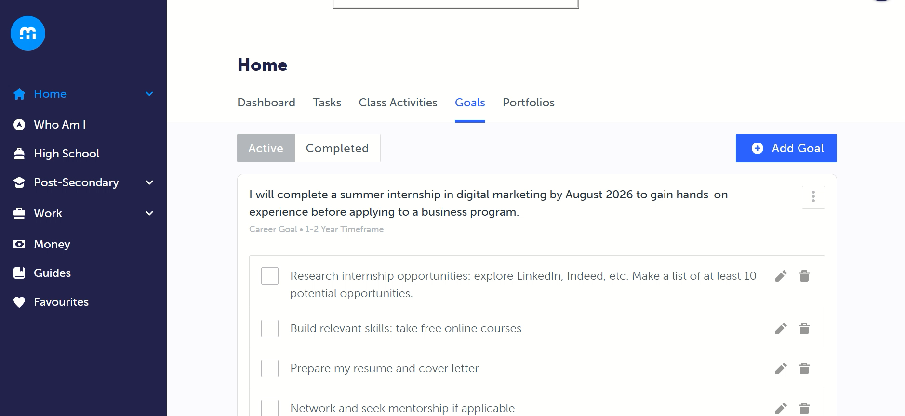

Slide 7
Updating your Goal for Life after High School
As you progress through high school, you may update your goal by completing certain tasks, adding new ones, or deleting ones that may no longer apply.
You can also add new goals if your pathway changes.
myBlueprint also provides ideas if you are unsure of where to start.

Slide 8
