Slide 1


Career Life Plan Workshop #2:
Five assessments & Identifying Pathways of Interest

Slide 2
Contacts
Career Transition Coaches:
Anna Paradis, ASD-East
Mariam Parekh, ASD-South
Sarah McLellan, ASD-West
EECD:
Tricia Berry, Learning Specialist for Career Connected Learning

Slide 3
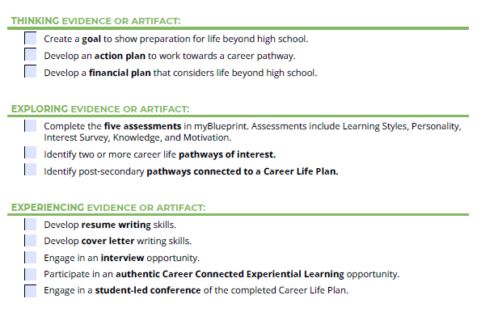
Career Life Plan Tasks

Slide 4
Purpose
By the end of today’s workshop, you will:
Have a better understanding of the five assessments (surveys) in myBlueprint (how to access them, how to support students in completing the assessments, and next steps once students have completed them).
Know how to support students in identifying pathways of interest utilizing myBlueprint.
Know where to go for further support.

Slide 5
Importance of the Assessments (Surveys)
Promotes Self-Awareness
Lays the Foundation for Career Exploration
Encourages Reflection and Goal-Setting
Supports Differentiated Pathways
Builds Engagement in Learning

Slide 6
How they can be used as a tool
The Who Am I surveys are a foundational tool for helping students begin the process of self-discovery, which is essential in career and life planning. These surveys—covering learning styles, personality, interests, knowledge, and motivation—provide students with structured opportunities to reflect on their strengths, preferences, and emerging identities.
Starting point for further conversations
Career pathway exploration
Personalized planning
Growth over time

Slide 7
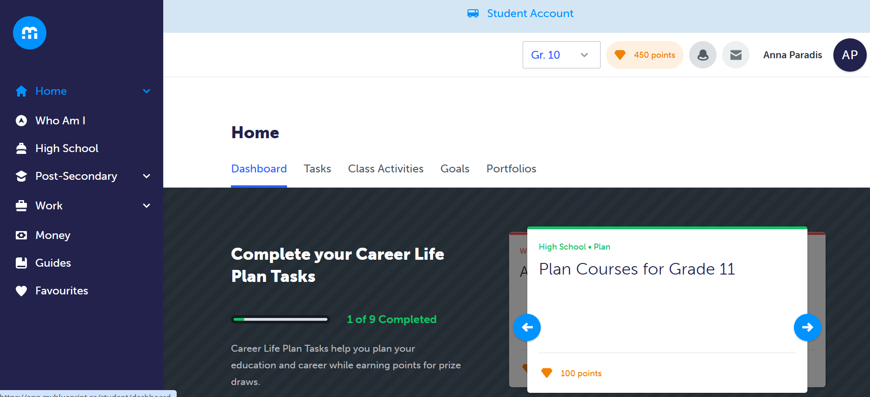
Complete the Who Am I Surveys

Slide 8
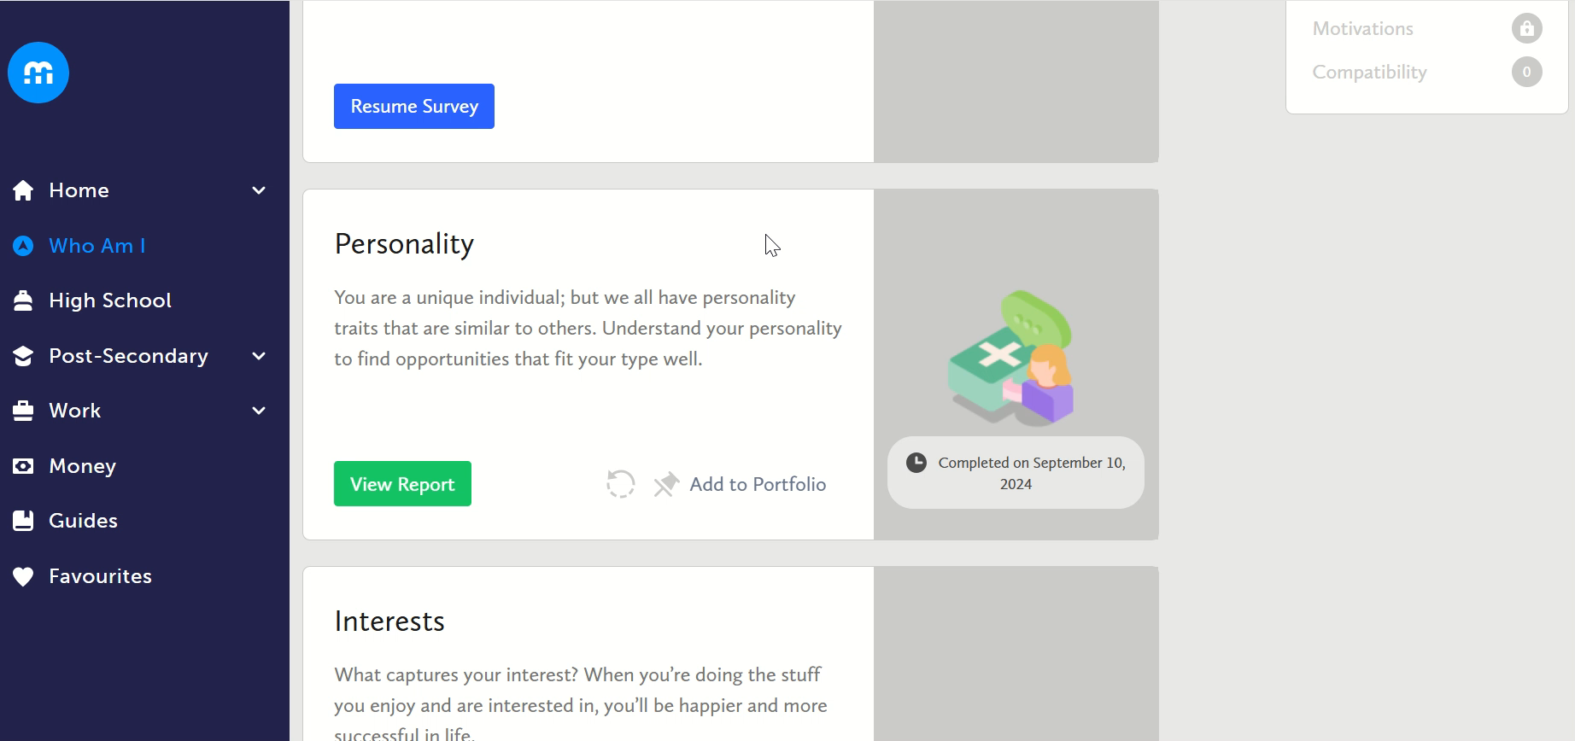
Adding to Portfolio & Restarting a Survey

Slide 9
Updates on Who am I Surveys
  A few examples of updated text:
    I tend to go back and forth in my thinking when reaching a decision. > I change my mind a lot before deciding.
    Evaluate the risks involved in going ahead with a project > Look at possible problems before starting a project
    A person who gives opinions or instructions in directing the judgement or conduct of others. > A person who guides and advises others.

Slide 10
Importance of the Occupation Feature
Expands awareness of possibilities
Connects interests to real opportunities
Supports informed decision-making
Normalizes exploration and flexibility
Links school to future pathways

Slide 11
Identifying 2 Career Life Pathways of Interest
Once students have completed all the Who Am I surveys, myBlueprint provides suggestions for potential occupations that may be a fit.
Encourage students to look through the suggestions to see if there are any occupations they would like to explore in greater detail.
On the “Who Am I” tab (where the surveys were found) you will also see a tab that says, “Match Results”.

Slide 12
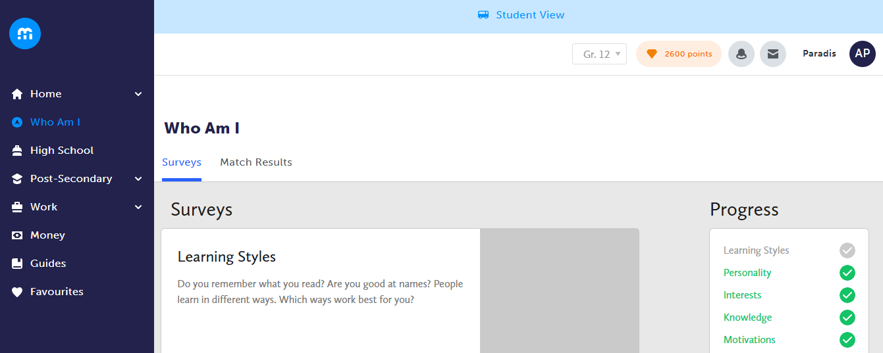

Slide 13
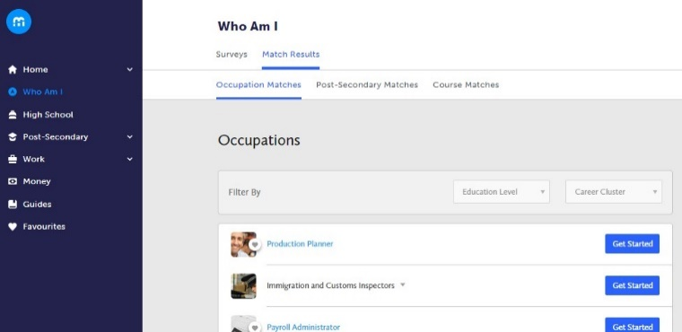
Identifying 2 Career Life Pathways of Interest
This tab will allow students to explore occupations. They are required to favourite a minimum of two occupation matches and learn more about the occupation.

Slide 14
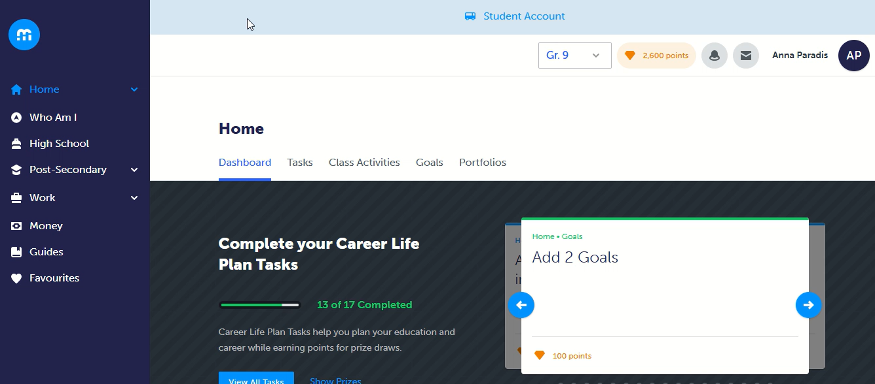
Identifying 2 Career Life Pathways of Interest
How to favourite an occupation and add to Career Life Plan portfolio.

Slide 15

Identifying 2 Career Life Pathways of Interest
For each of the occupations, students can also do a quick quiz to determine what percentage they are a match. To complete the quiz, click on the “get started” button.

Slide 16
Resources
Career Life Plan Information: https://hopefultransitions.nbed.ca/career-life-plan/
myBlueprint support videos:
  Who am I Surveys: https://myblueprint.ca/support/videos/education-planner/4oRGDJsN1Sk4KyuKgyO2M8
  Occupations: https://myblueprint.ca/support/videos/education-planner/7IqJVHmA1O22C8CKO8Eso4
Journal entry prompts for identifying pathways of interest
Lesson plan: Identify two or more career life pathways of interest.

Slide 17
Workshop Schedule
Workshop 3: Identifying post-secondary pathways / goals / action plans | Wednesday, October 22, 2025 3:30pm – 4:15pm | Join the meeting now Meeting ID: 282 229 433 321 6 Passcode: 6we9JH99
Workshop 4: Developing a financial plan / Participate in an experiential learning opportunity | Wednesday, November 26, 2025 3:30pm – 4:15pm | Join the meeting now Meeting ID: 280 845 620 698 8 Passcode: R6Jq3pV9
Workshop 5: Resume / Cover letter | Wednesday, January 21, 2025 3:30pm – 4:15pm | Join the meeting now Meeting ID: 247 884 541 633 0 Passcode: sY6Sb7Dr
Workshop 6: Interviews | Wednesday, February 18, 2025 3:30pm – 4:15pm | Join the meeting now Meeting ID: 246 870 803 464 3 Passcode: MS9Zk6o4
Workshop 7: Student led conference | Wednesday, March 18, 2025 3:30pm – 4:15pm | Join the meeting now Meeting ID: 225 518 008 767 8 Passcode: U3HR9fP9
Workshop 8: Check-ins | Wednesday, April 22, 2025 3:30pm – 4:15pm | Join the meeting now Meeting ID: 259 710 809 892 Passcode: EF6Pe7ku
Workshop 9: Supports / Planning for next year | Wednesday, May 13, 2025 3:30pm – 4:15pm | Join the meeting now Meeting ID: 226 729 432 886 0 Passcode: c8wv235X
Notes:
Supports preparation for work placements

