Slide 1


Career Life Plan Workshop #3:
Identifying post-secondary pathways / goals / action plans

Slide 2
Contacts
Career Transition Coaches:
Anna Paradis, ASD-East
Mariam Parekh, ASD-South
Sarah McLellan, ASD-West
EECD:
Tricia Berry, Learning Specialist for Career Connected Learning

Slide 3
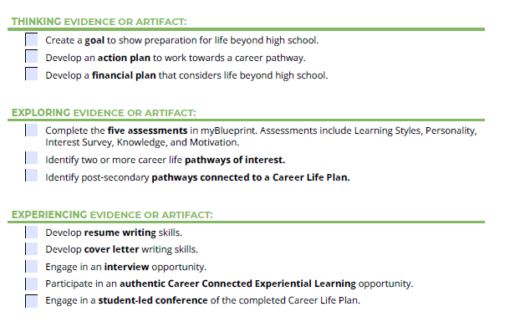
Career Life Plan Tasks

Slide 4
Purpose
By the end of today’s workshop, you will:
Know how to support students in exploring post-secondary options (apprenticeship, college, university, workplace, entrepreneurship)
Identify personal goals & pathways
Use My Blueprint to support decision-making
Create a realistic action plan

Slide 5
Importance of exploring Post-Secondary Pathways
Informed Decision-Making
Goal Setting and Planning
Career Alignment
Exposure to Options
Academic Planning
Reflection and Readiness
Building Confidence and Agency
Notes:
Informed Decision-Making
myBlueprint allows students to compare programs, schools, and admission requirements across Canada. By exploring early, students can understand what courses and grades they’ll need in high school to qualify for their preferred programs.
Goal Setting and Planning
Students can set short- and long-term goals related to education, career, and life, and then map out the steps needed to achieve them. This builds ownership and motivation.
Career Alignment
Each post-secondary option is connected to career interests and assessments in myBlueprint. Students can see how their skills and preferences align with specific fields or programs — helping them choose pathways that fit who they are.
Exposure to Options
Students often only know about a few post-secondary choices (e.g., university or college). myBlueprint introduces them to a full range of options, including apprenticeships, trades, private colleges, and direct-to-work opportunities.
Academic Planning
Exploring post-secondary pathways helps students plan their high school courses strategically — ensuring they meet prerequisites and keep doors open for their desired programs.
Reflection and Readiness
Through pathway exploration, students learn to reflect on their interests, strengths, and values — key components of the Career Life Plan and overall graduation requirements in New Brunswick.
Building Confidence and Agency
When students explore post-secondary options themselves, they gain confidence in navigating information, advocating for their goals, and taking ownership of their future.

Slide 6
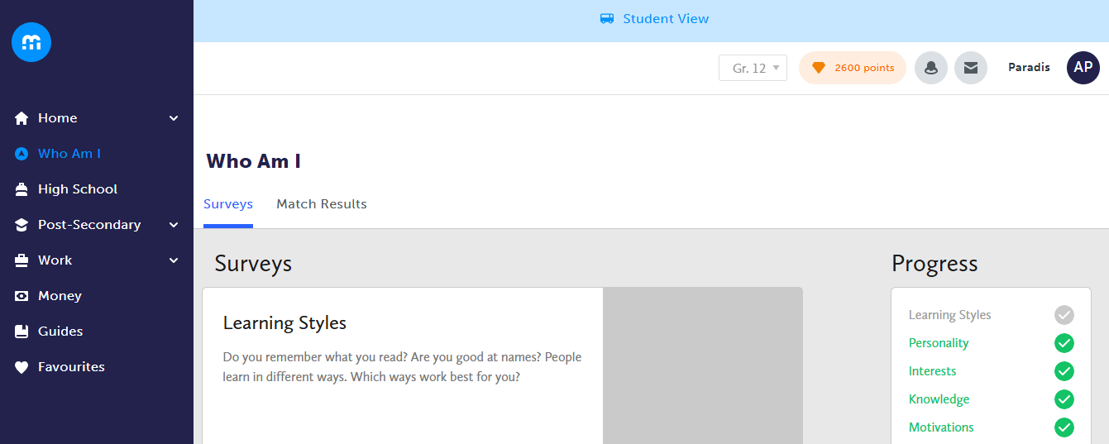
Notes:
Students can find possible post-secondary matches on the Who am I tab in myBlueprint

Slide 7
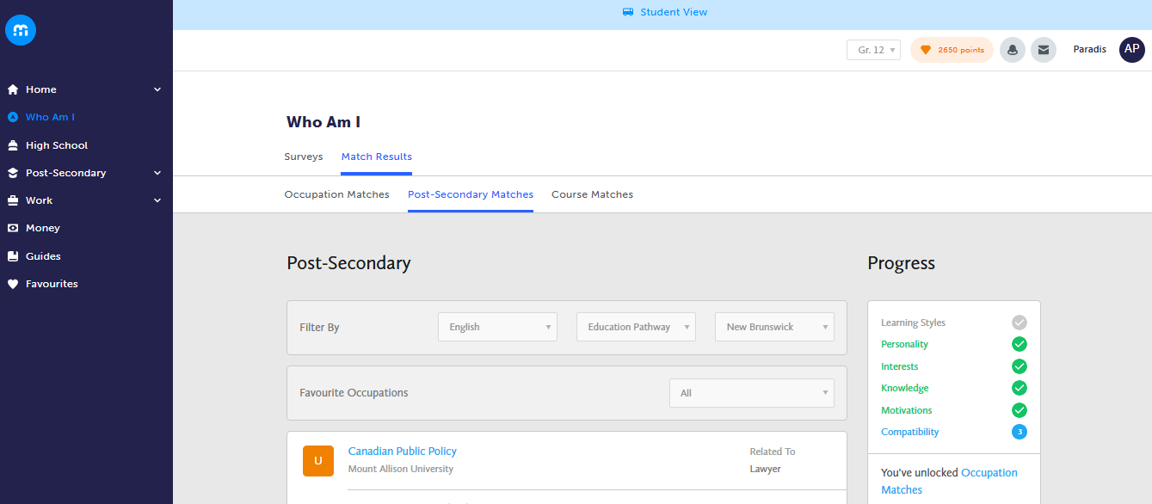
Notes:
Students post-secondary matches will appear in this tab

Slide 8
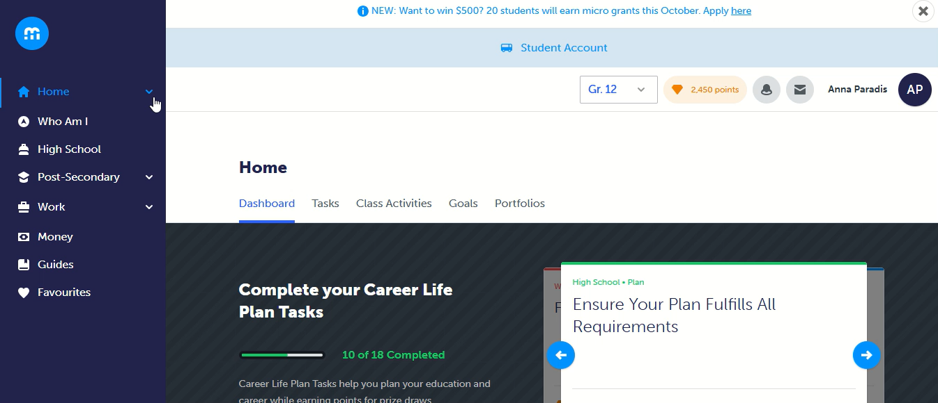
Notes:
We have created a lesson plan resource (graphic organizer) that will allow students to dive deeper into their post-secondary options. This will be included in the resource package for today’s workshop.

Slide 9
Importance of Creating a Goal and Action Plan
Demonstrating Readiness for the Future
Turning Ideas into Action
Connecting School to the Future
Building Self-Awareness
Tracking Growth Over Time
Notes:
Demonstrating Readiness for the Future
Creating a goal in myBlueprint helps students show they are actively preparing for life after graduation — whether that means continuing their education, entering the workforce, or pursuing personal growth. It reflects intentional planning and readiness for the transition beyond high school.
Turning Ideas into Action
The goal-setting tool helps students break big dreams into smaller, achievable steps. By identifying actions and timelines, students learn how to move from “I want to…” to “Here’s how I’ll do it,” which builds practical planning and organization skills.
Connecting School to the Future
By linking goals to courses, extracurricular activities, or community experiences, students can see how what they’re doing now supports where they want to go. This makes learning more relevant and purposeful.
Building Self-Awareness
Students are encouraged to think about their interests, strengths, and values when setting goals. This reflection helps them better understand who they are and what’s important to them — key parts of lifelong career and personal development.
Tracking Growth Over Time
myBlueprint allows students to revisit and update goals as they learn more about themselves and their options. This shows growth, adaptability, and perseverance — all essential skills for success beyond high school.

Slide 10
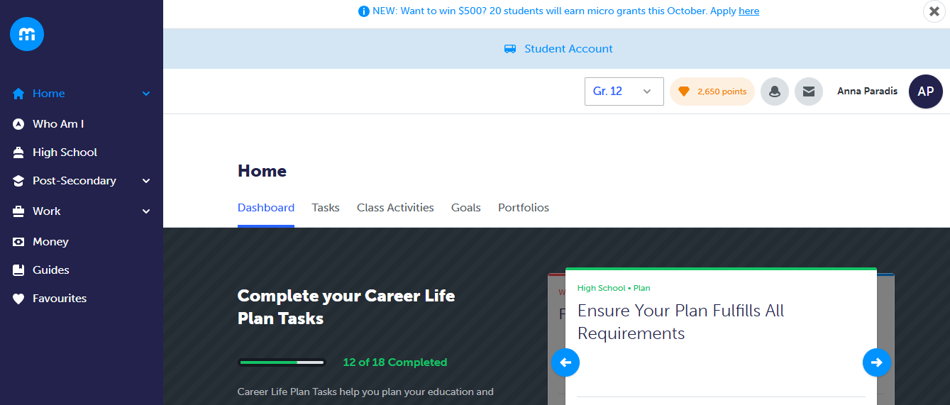

Slide 11
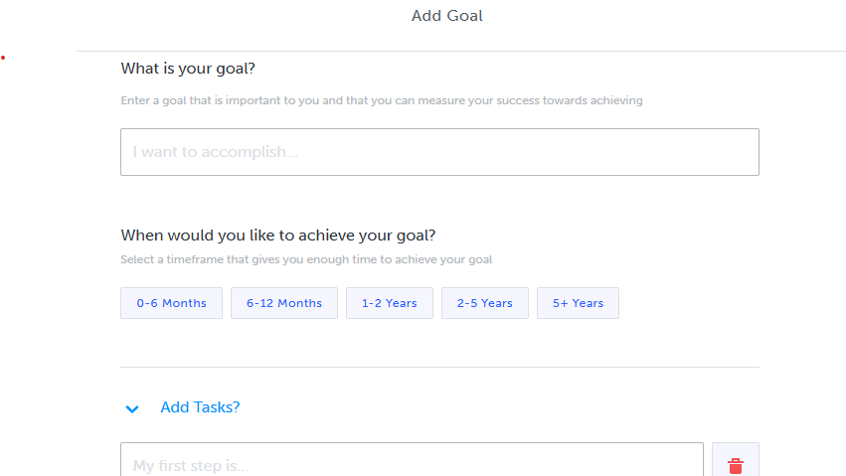

Slide 12
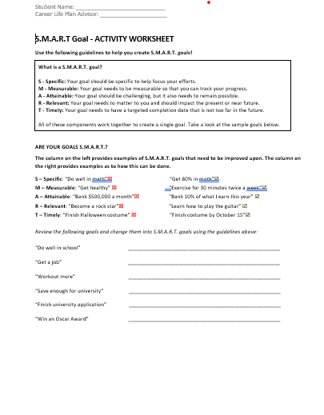
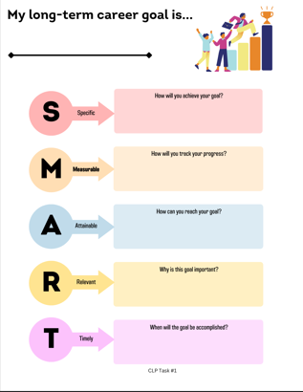
Video to show class - LearnStorm Growth Mindset: How to write a SMART goal (youtube.com)
Notes:
I will also add these resources to our package if you want to dive deeper into making goals with your students, these resources focus on what is a smart goal and how to make on. A well-written SMART goal informs an action plan.
Once completed students can either add them to their digital portfolio in myBlueprint but uploading them or creating a summary through a journal entry. As well, some schools may choose to have paper portfolio for their students and these could be added there, its completely up to you.

Slide 13
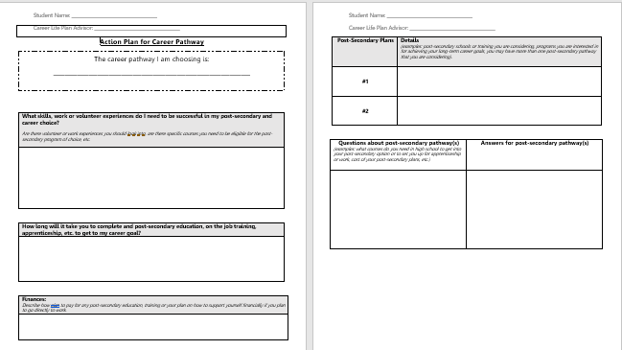

Slide 14
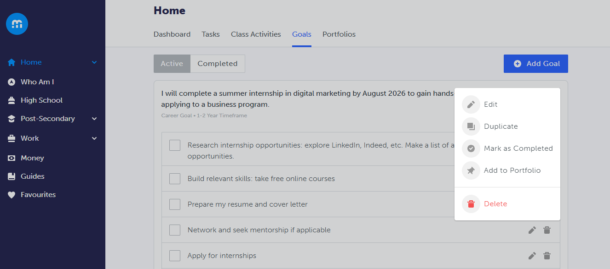
Notes:
Students can use the myBlueprint goal setting tool to create their goal and add to their Career Life Plan portfolio. If they need support in how to create the goal, we have a SMART goal worksheet that will be provided in the resource package to help students generate ideas and build out their goal. They can then take that information and input it in the goal setting tool on myBlueprint and easily add to their portfolio.

Slide 15
Workshop Schedule
Workshop 4: Developing a financial plan / Participate in an experiential learning opportunity | Wednesday, November 26, 2025 3:30pm – 4:15pm | Join the meeting now Meeting ID: 280 845 620 698 8 Passcode: R6Jq3pV9
Workshop 5: Resume / Cover letter | Wednesday, January 21, 2025 3:30pm – 4:15pm | Join the meeting now Meeting ID: 247 884 541 633 0 Passcode: sY6Sb7Dr
Workshop 6: Interviews | Wednesday, February 18, 2025 3:30pm – 4:15pm | Join the meeting now Meeting ID: 246 870 803 464 3 Passcode: MS9Zk6o4
Workshop 7: Student led conference | Wednesday, March 18, 2025 3:30pm – 4:15pm | Join the meeting now Meeting ID: 225 518 008 767 8 Passcode: U3HR9fP9
Workshop 8: Check-ins | Wednesday, April 22, 2025 3:30pm – 4:15pm | Join the meeting now Meeting ID: 259 710 809 892 Passcode: EF6Pe7ku
Workshop 9: Supports / Planning for next year | Wednesday, May 13, 2025 3:30pm – 4:15pm | Join the meeting now Meeting ID: 226 729 432 886 0 Passcode: c8wv235X
Notes:
Supports preparation for work placements

