Slide 1

CAREER LIFE PLAN IMPLEMENTATION
Administrators Discussion
April 2026

Slide 2

CONTEXT
The Career Life Plan has transitioned from ESS to Curriculum, however, it still very much lives in both worlds.
Last year, we met in April to discuss how the Career Life Plan could be met for 2026 grads who were not explicitly exposed to it throughout their high school years. Schools worked hard to come up with plans that would work best for their context.
Moving forward, we will support schools in implementing the Career Life Plan across Grades 9–12 to prepare learners for pathways after graduation.
Considerations need to be given to how the Career Life Plan will be met in Alternative Learning Sites.

Slide 3
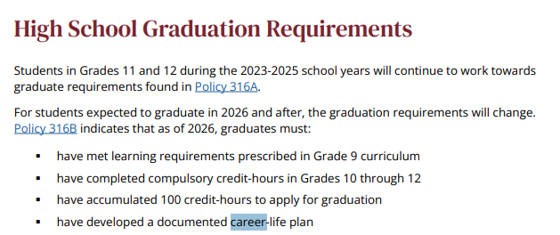

CAREER LIFE PLAN BASICS
1
It is a graduation requirement
2
 | There are 11 requirements for the Career Life Plan; ideally students would work on these outcomes throughout their high school careers.
11 minimum requirements

Slide 4

CAREER LIFE PLAN COMPANION DOCUMENT WALKTHROUGH

Slide 5
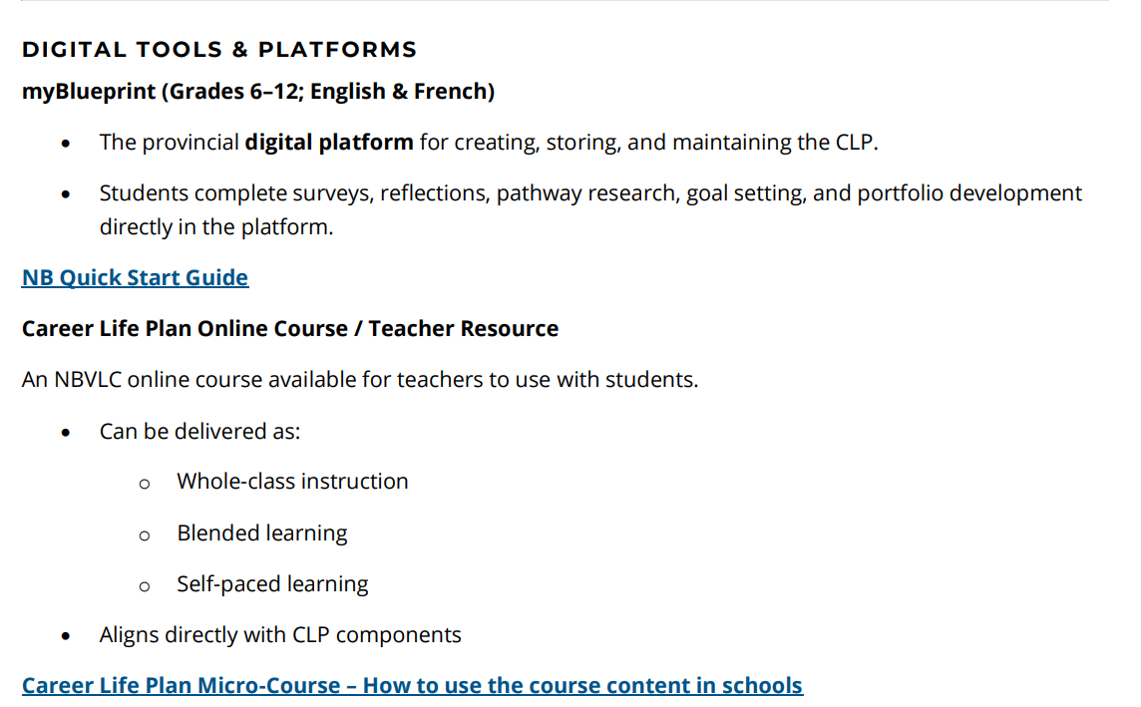
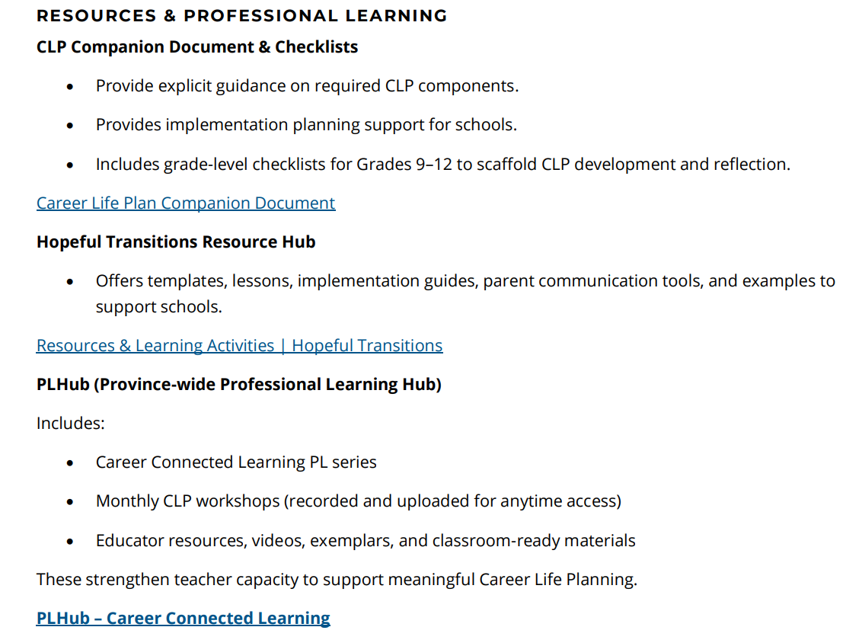
QUICK START TOOL KIT
Pages 2-5

Slide 6
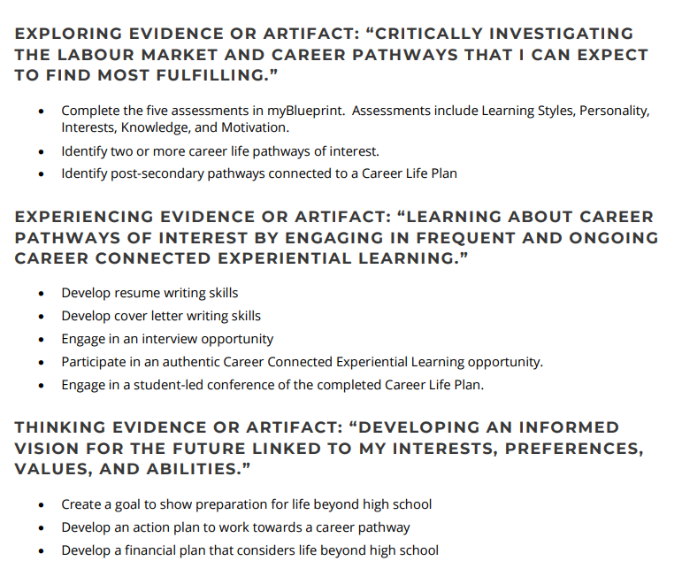
MINIMUM REQUIREMENTS
Pages 7-9

Slide 7
IMPLEMENTATION
Pages 9-12
Key Points from this section:
The key to meeting the provincial standard is to ensure all students are engaged in intentional decision-making and continuous.
Career Connected Learning across grades 9-12. Given the personalized nature of the Career Life Plan process, there is not a “one-size fits all” approach. Each school should consider their context, strengths, and leverage them to intentionally support learners in the development of their own Career Life Plan.
3. Implementation ideas

Slide 8
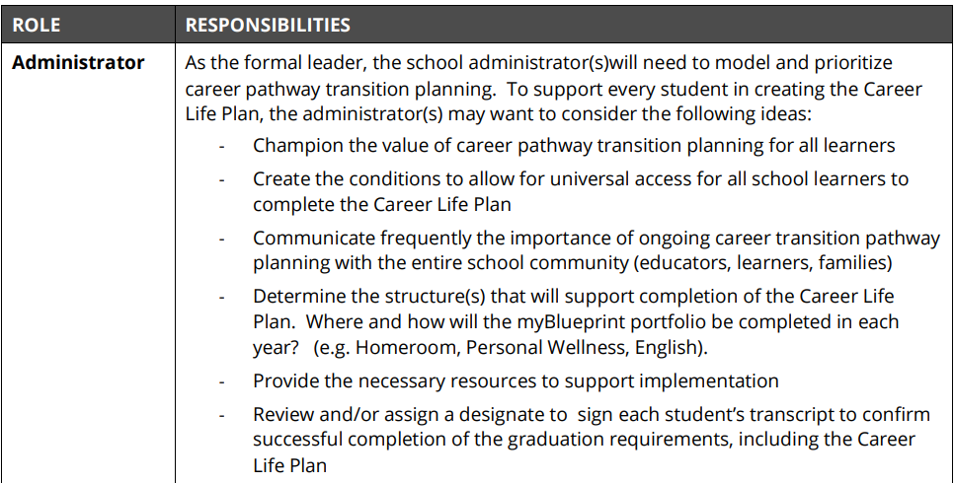
ROLES AND RESPONSIBILITIES
Pages 13-14

Slide 9
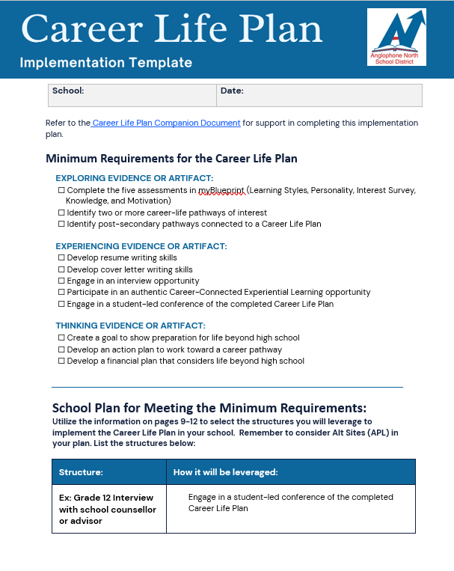
CAREER LIFE PLAN IMPLEMENTATION TEMPLATE
All schools are asked to create an implementation plan for the Career Life Plan.
The implementation plan is being submitted to district Director in some districts

Slide 10
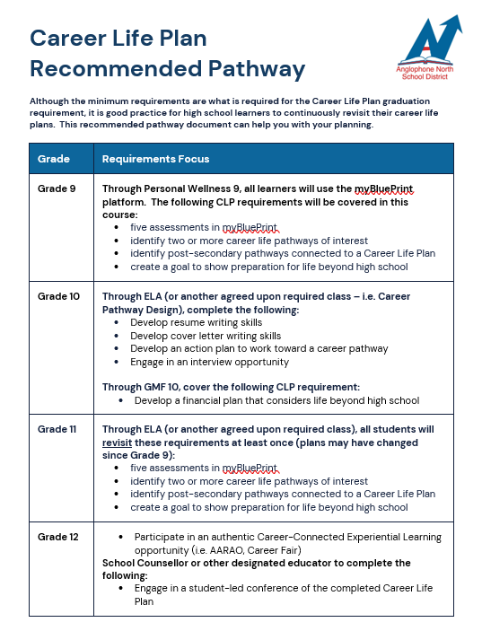
PATHWAYS SUPPORT DOCUMENT

Slide 11
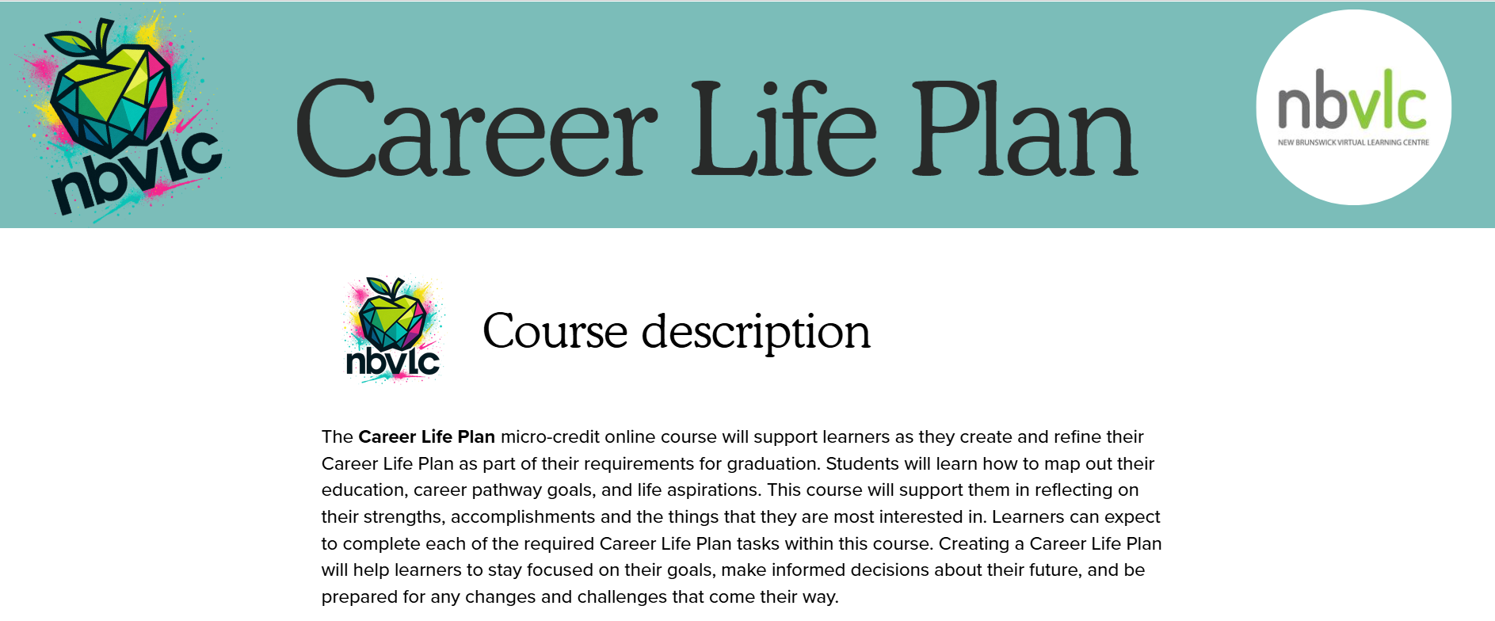
CAREER LIFE PLAN
MICRO-COURSE
We recommend this digital micro-course for learners who attend Alt Sites.
You may also find that it’s a good fit for your school plan.

Slide 12
myBlueprint
-The great thing about the students using myBlueprint, is that it will cover the majority of what is required in the Career Life Plan. It will also track which portions student have completed and what still needs to be done.
-Looking at the requirements, the only ones that couldn't be done on myBlueprint would be:
-engage in an interview opportunity (although it can be documented on myBlueprint)
-participate in an authentic Career Connected Experiential Learning opportunity
-engage in a student-led conference of the completed career life plan

Slide 13
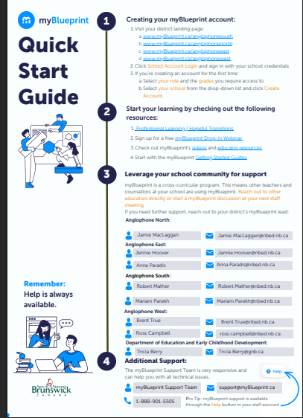
myBlueprint
This is the landing page that needs to be used by both staff and students when logging into myBlueprint

Slide 14
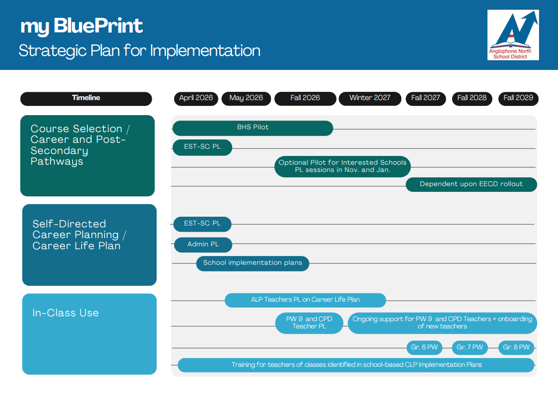

Slide 15
QUESTIONS?

